Slide 1
Technology and Operations Management (TOM)
Rakesh Kumar
2025-2026
FOSTIIMA

Slide 2
Chapter 1 Introduction
LO1-1: Identify the elements of operations and supply chain management (OSCM).
LO1-2: Know the potential career opportunities in operations and supply chain management.
LO1-3: Recognize the major concepts that define the operations and supply chain management field.
LO1-4: Evaluate the efficiency of a firm.

Slide 3
Who am I?
Rakesh Kumar
Rakesh.Kumar@fostiima.org
9810078614
BE IIT Roorkee, PGDM IIM Ahmedabad, LL.B. Meerut University
44 years work experience in Operations and Supply Chain

Slide 4
Language of Communication/Teaching Style
Hindi or English
Theory-Experience-Numericals-Data-Tables-Log tables-Formulae-Graphs
Case Study
Are examples same for all classes?
Experience what you are taught!

Slide 5
Course Structure and Assessment
Will be decided and communicated through LMS

Slide 6
Reference Reading
Operations and Supply Chain Management
Chase, Shankar, and Jacobs
15th and 17th Edition
McGrawHill Publication

Slide 7
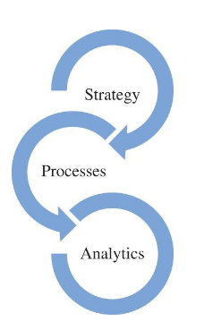
Success Depends On
Clever integration of a great operations-related strategy
Processes to deliver products and services
Analytics to support the decisions needed to manage the firm
Indigo to be first in world to use 3 ladders to disembark, and reduce time from 13 to 7 minutes.
Not to serve hot food to save weight of microwave

Slide 8
What Is Operations and Supply Chain Management?
The design, operation, and improvement of the systems that create and deliver the firm’s primary products and services
Operations and supply chain management (OSCM) is
  A functional field of business
  Clear lines management responsibilities
  Concerned with the management of the entire production/delivery system

Slide 9
Operations and Supply Chain Terms
Operations
Supply Chain
Manufacturing and service processes used to transform resources into products
Processes that move information and material to and from the firm

Slide 10
Basic Principles that Guide the Design of Transformation Processes
How different types of processes are organized
How to determine the capacity of a process
How long it should take to make a unit
How the quality of a process is monitored
How information is used to make decisions

Slide 11
Process Activities
Planning – processes needed to operate an existing supply chain
Sourcing – selection of suppliers that will deliver the goods and services needed to create the firm’s product
Making – producing the major product or service
Delivering – logistics processes such as selecting carriers, coordinating the movement of goods and information, and collecting payments from customers
Returning – receiving worn-out, excess, and/or defective products back from customers

Slide 12
Supply Chain Processes
Exhibit 1.3

Slide 13
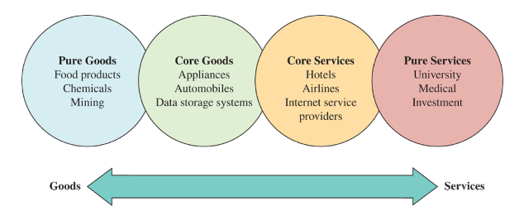
The Goods–Services Continuum
Exhibit 1.4

Slide 14
Careers in OSCM
OSCM careers specialize in managing the planning, production, and distribution of goods and services
Operations and supply chain manager works with people to figure out the best way to deliver the goods and services of the firm
OSCM jobs are hands-on, working with people and figuring out the best way to do things

Slide 15
OSCM Specialist Areas
Product design
Purchasing
Manufacturing
Service operations
Logistics
Distribution

Slide 16
Possible Careers in OSCM
Plant manager
Hospital administrator
Branch manager
Department store manager
Call center manager
Supply chain manager
Purchasing manager
Business process improvement analyst
Quality control manager
Lean improvement manager
Project manager
Production control analyst
Facilities manager
Chief operating officer

Slide 17
Time Line Depicting When Major OSCM Concepts Became Popular
Exhibit 1.5

Slide 18
The Major Concepts that Define the OSCM Field
Manufacturing strategy paradigm
Lean manufacturing, JIT, and TQC
Service quality and productivity
Total quality management and quality certification
Business process reengineering
Six sigma quality
Supply chain management
Electronic commerce
Sustainability and the triple bottom line
  Business strategy that includes social, economic and environmental criteria
Business analytics

Slide 19
Efficiency, Effectiveness, and Value
Efficiency - doing something at the lowest possible cost
Effectiveness - doing the right things to create the most value for the company
Value - quality divided by price
  Quality - the attractiveness of the product, considering its features and durability

Slide 20
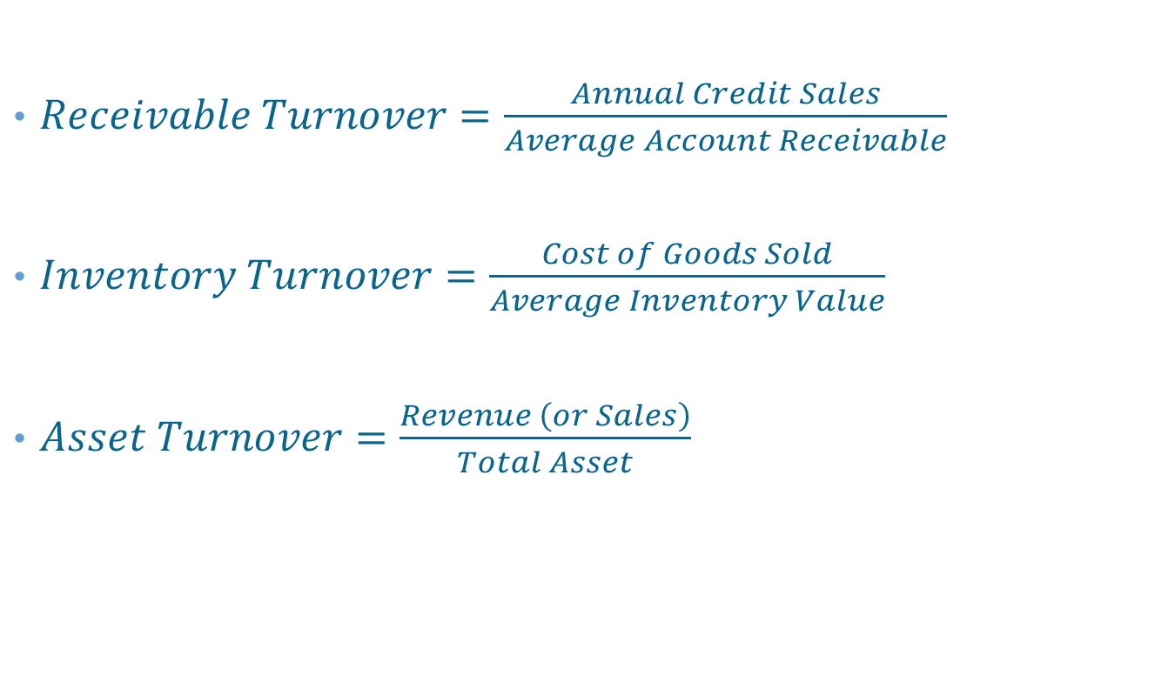
Management Efficiency Ratios
$Receivable Turnover=\frac{Annual Credit Sales}{Average Account Receivable}$
$Inventory Turnover=\frac{Cost of Goods Sold}{Average Inventory Value}$
$Asset Turnover=\frac{Revenue \left(or Sales\right)}{Total Asset}$

Slide 21
Summary
Processes are used to implement the strategy of the firm
Analytics are used to support the ongoing decisions needed to manage the firm
OSCM people specialize in managing the production of goods and services
OSCM jobs are hands-on and require working with others and figuring out the best way to do things
The chief operating officer (COO) works with the CEO and company president to determine the company’s competitive strategy
COOs determine an organization’s location, its facilities, which vendors to use, and how the hiring policy will be implemented
Many of the concepts that form the OSCM field have their origins in the Industrial Revolution in the 1800’s

